Slide 1
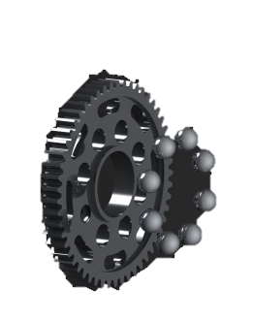
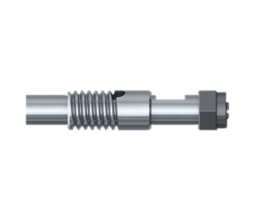
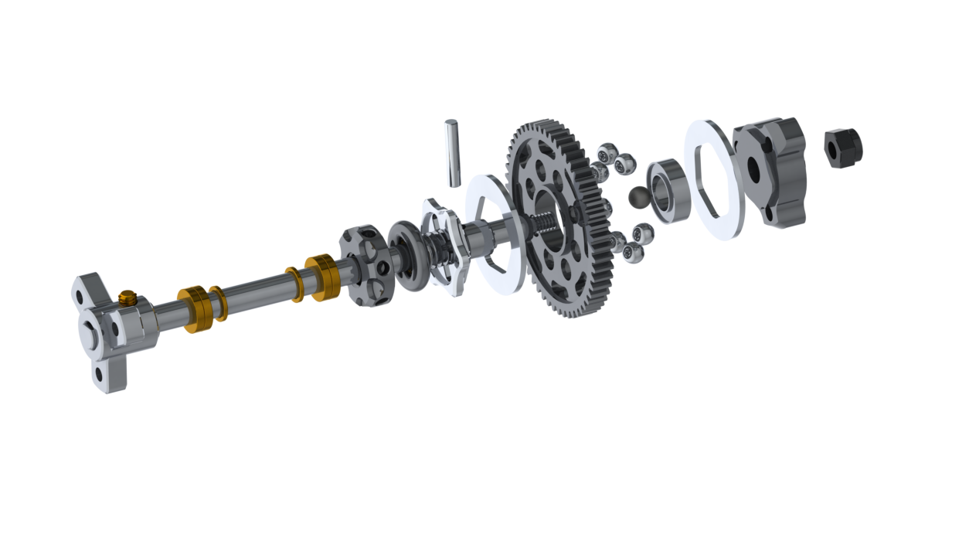

01 - DIFFERENTIAL
01 – ASSEMBLY TIPS
14
10
DIFF GREASE
7
8
9
13
6
4
12
11
1
6
2
3
5
MAKE SURE IT’S FULL TIGHTEN
1
THE BALLS SHOULD “POP” TO
BE INSERTED OR REMOVED

Slide 2
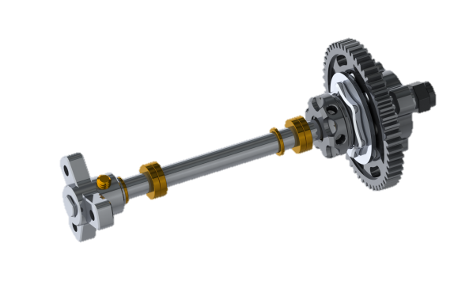
01 – SETUP TIPS
BAG – 1 CONTENT
PARTS
1 | XB1-048-1 | Diff Whell Hub 1
2 | F1-059 | Diff Aluminum 7075 Shaft
3 | XB1-048-3 | Diff Adjustor Hub
4 | XB1-048-4 | Oring 3x7x2
5 | XB1-048-5 | Diff Hub Pressure Plate
6 | XB1-048-6 | Diff Pressure Plate
7 | XB1-048-7 | Diff 64P 53T Spur Gear
8 | XB1-048-8 | Ceramic Balls
9 | XB1-048-9 | Bearing 4x7x2
10 | XB1-099 | Diff Whell Hub 2
11 | XB1-048-13 | Lock Nut M2
12 | X-WSH-3-5-0.5 | Washer 3x5x0.5
13 | F1-041 | Washer 3x5x1
14 | XB1-048-17 | 1.5mm Axle
PARTS
BOLTS
TIGHTEN – MORE STEERING
LOOSEN – LESS STEERING
1 | X-SSS-2.5-2 | M2.5x2mm

